Slide 1
Training Process and Resource Costs of Generative AI Large Language Models
Homakesavadurgaprasad
3SU2026 Model Development
05/27/2026

Slide 2
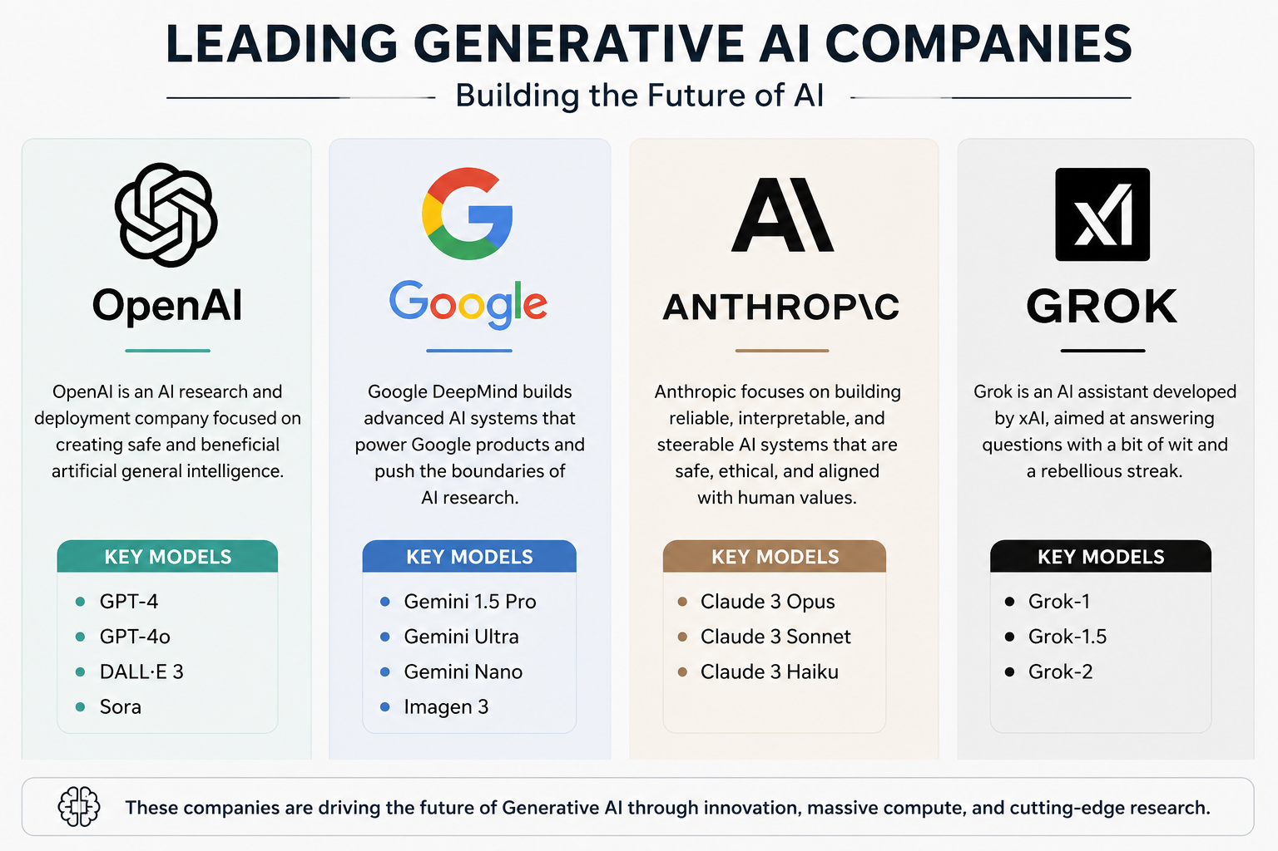
What is an LLM?
LLM (Large Language Model) – An AI system trained on massive amounts of text data to understand and generate human-like language.
Examples:
OpenAI – ChatGPT (GPT-4)
Google – Gemini
Anthropic – Claude
Meta – LLaMA
Microsoft – Copilot

Slide 3
LLM Training Process
Data Collection
Data Cleaning
Tokenization
Model Training
Deployment
Evaluation
Fine Tuning

Slide 4
Resource required
Datasets
Terabytes of internet text, books, and code
Sources: Common Crawl, Wikipedia, GitHub, news articles
GPUs / TPUs
NVIDIA A100 / H100 GPU clusters
Google TPU v4/v5 pods for large-scale training
Energy
Massive electricity consumption during training
GPT-3 training used approx. 1,287 MWh of energy
Time
Pre-training takes weeks to months
Fine-tuning and testing add additional time
Cloud Infrastructure
Microsoft Azure, AWS, Google Cloud platforms
Distributed computing across thousands of nodes
Engineers / Researchers
Large teams of ML engineers, data scientists, and researchers
Roles include model training, evaluation, safety, and deployment

Slide 5
Cost of Training Popular Models
Model | Company | Estimated Cost
GPT-4 | OpenAI | $100M+
Gemini | Google | $200M+
Claude | Anthropic | $50M - $100M
LLaMA 3 | Meta | $30M - $50M
Grok | xAI | Multi-million
Why Does Training Cost So Much?
Thousands of GPUs running for weeks or months
Massive cloud infrastructure and energy bills
Large teams of engineers and researchers
Data collection, cleaning, and storage costs
Key Cost Factors:
Compute – GPU/TPU rental or purchase costs
Energy – Electricity for powering and cooling servers
Data – Licensing, collecting, and processing datasets
Talent – Salaries for top AI researchers and engineers
Infrastructure – Cloud storage, networking, and security

Slide 6
Challenges & Impact
High Electricity Consumption
Training a single LLM can consume millions of kilowatt-hours
GPT-3 training emitted approx. 552 tons of CO2
Continuous inference (daily usage) adds even more energy cost
Data centers run 24/7 requiring constant power supply
Expensive Hardware
NVIDIA H100 GPU costs approx. $30,000 - $40,000 per unit
Large models require thousands of GPUs running in parallel
Hardware upgrades needed frequently as models grow larger
Not affordable for small companies or individuals
Environmental Impact
High carbon footprint from energy-intensive training
Large water usage for cooling data center servers
E-waste from frequent hardware upgrades
Growing concern among researchers about AI sustainability
Need for Distributed Computing
Single machines cannot handle LLM training alone
Requires thousands of nodes working together
Complex networking and synchronization challenges
Specialized frameworks needed like PyTorch, Horovod, DeepSpeed
AI Accessibility Challenges
Only large tech giants can afford to build frontier LLMs
Developing countries have limited access to AI tools
High API costs limit usage for small businesses and startups
Risk of creating a digital divide between rich and poor nations

Slide 7
Conclusion
LLM Training Requires Huge Infrastructure
Training LLMs demands thousands of GPUs and TPUs
Requires massive cloud platforms like AWS, Azure, and Google Cloud
Distributed computing systems are essential for large-scale training
No single machine can handle the full training process alone
Compute and Energy Are Major Costs
Training costs range from millions to over $100 million
Energy consumption is one of the biggest ongoing expenses
GPT-4 alone cost an estimated $100M+ to train
Inference costs add up daily with millions of users worldwide
Better Hardware Improves Performance
Newer GPUs like NVIDIA H100 significantly speed up training
Improved chips reduce training time from months to weeks
Custom AI chips like Google TPUs and AWS Trainium boost efficiency
Hardware innovation directly drives LLM capability improvements
AI Development Needs Large Investments
Only well-funded companies can build frontier AI models
Billions of dollars invested annually by OpenAI, Google, and Meta
Government and private funding critical for AI research growth
Startups rely heavily on venture capital to compete in AI space

